Slide 1
Real-time Cyberbullying Detection on Twitter Using SparkNLP
Dr. M.John Basha – Mentor
A Rishab Vanigotha - 19BTRCR018
M R Naveen Kumar - 19BTRCR005
Shraddha Hiremath - 19BTRCR037
Sujay Sukumaran Adityan - 19BTRCR051

Slide 2
Objective
The goal of this project is to create a system that can effectively detect and address cyberbullying on Twitter in real-time, providing a valuable tool for addressing this per
This will involve using snscrape to ingest streaming data from Twitter, processing the data using Spark NLP, and using pre-trained models from Spark NLP to detect and filter out potentially harmful messages in real-time problem.

Slide 3
Abstract
Natural language processing (NLP) is a crucial component of many applications that involve working with text data.
In this project, we propose a real-time cyber bullying detection system for Twitter using Spark NLP, a powerful and scalable natural language processing library.
Our system ingests streaming data from Twitter using snscrape and processes it using Spark NLP. We use pre-trained models from Spark NLP for Cyber bullying in real-time.
Our results show that our system is able to effectively detect and filter out cyber bullying messages on Twitter in real-time, providing a valuable tool for addressing this pervasive problem.

Slide 4
Literature survey
S.no | Name | Authors | Year of publication | Summary
1 | An Application to Detect Cyberbullying Using Machine Learning and Deep Learning Techniques | Mitushi Raj, Samridhi singh, Kanishka Solanki, Ramani Selvanambi | 2022 | The most accurate network is the CNN-BiLSTM network. While the CNN alone can only train local characteristics from word n-grams, the CNN-BiLSTM can also learn global features and long-term dependencies because to its LSTM layer.
2 | Cyber Bullying Detection on Social Media using Machine Learning | Aditya Desai, Shashank Kalaskar, Omkar Kumbhar, Rashmi Dhumal | 2021 | A semi-supervised approach in detecting cyberbullying based on the five features that can be used. The BERT model achieved 91.90% accuracy when trained over dual cycles which outperformed the traditional machine learning models
3 | Cyber Bullying Detection for Twitter Using ML Classification Algorithms | Muskan Patidar | 2021 | The study evaluated the current literature for several machine learning algorithms and discovered that the Naive bayes N-gram model that results in maximum 67% accuracy
4 | Accurate Cyberbullying Detection and Prevention on Social Media | Andrea Pereraa , Pumudu Fernando | 2020 | In this paper, the author has presented the proposed solution which uses NLP techniques and supervised machine learning to detect cyberbullying accurately. The proposed solution resulted in 74.50% accuracy along with 74% precision, 74% recall and 74% F1 Score.
5 | A Study of Cyberbullying Detection Using Machine Learning Techniques | Saloni Mahesh Kargutkar, Prof. Vidya Chitre | 2020 | The author employed a CNN implementation strategy with Keras in this paper, resulting in noisy labels.

Slide 5
Literature survey
S.no | Name | Authors | Year of publication | Summary
6 | Opinion Mining of Twitter Data using Hadoop and Apache Pig | Anjali Barskar and Ajay Phulre | 2017 | Pig is intended for deep Hadoop analysis and also integrates with the flume is ecosystem for data retrieval and storage in HDFS. We can also detect the polarity of the tweet, which tells us whether the tweet has a positive or negative meaning.
7 | Identifying sarcasm in twitter: a closer look | González-Ibánez, Muresan, & Wacholder Kumar & Bala | 2016 | Tweepy and Twitter4j are used to stream Twitter tweets. Because of some limitations imposed by Twitter on the streaming API, one can only download a certain number of tweets in a particular time window.
8 | Big data emerging technologies: A case study with analyzing twitter data using apache hive | Ennaji, El Fazziki, Sadgal, and Benslimane | 2015 | Hadoop framework for extracting and evaluating customers' opinions about a product from social networks, the provided framework extracts and analyses social customer relationship management opinions
9 | Multi-class tweet categorization using map reduce paradigm | Mohit Tare, Indrajit Gohokar, Jayant Sable, Devendra Paratwar, Rakhi Wajgi | 2014 | To classify the vast quantity of tweets, a Naive Bayes algorithm was applied. Tweets were collected using the Twitter4j library, which leverages the Twitter REST API internally.
10 | Session-based Cyberbullying Detection in Social Media | Peiling Yia, Arkaitz Zubiaga | - | we review existing approaches to cyberbullying detection, with a particular focus on session-based bullying. We examine the Social media Session-based Cyberbullying Detection framework (SSCD)

Slide 6
Existing system
The existing system has three stages: gathering, preprocessing, and modelling.
During the collection phase, multiple techniques like as Tweepy, and Twitter4j are utilized to stream Twitter tweets. These methods are confined to short-term data.
Flume can be used to retrieve long-term data, but the current version is incompatible with the Twitter API.
In model building phase classical Machine Learning approaches are used which results in lower accuracy and takes longer time to train.

Slide 7
Proposed system
Our solution is based on the spark. Essentially, our research attempts to gain insights on streaming data using spark.
Ingest streaming data from Twitter using snscrape.
Preprocess the data using Spark NLP components, such as the Document Assembler, Tokenizer, and Normalizer, to convert the raw text into a format that can be processed by the system.
Use pre-trained models from Spark NLP to create Embeddings for the text
Filter out the identified messages in real-time to prevent them from being published on Twitter.

Slide 8
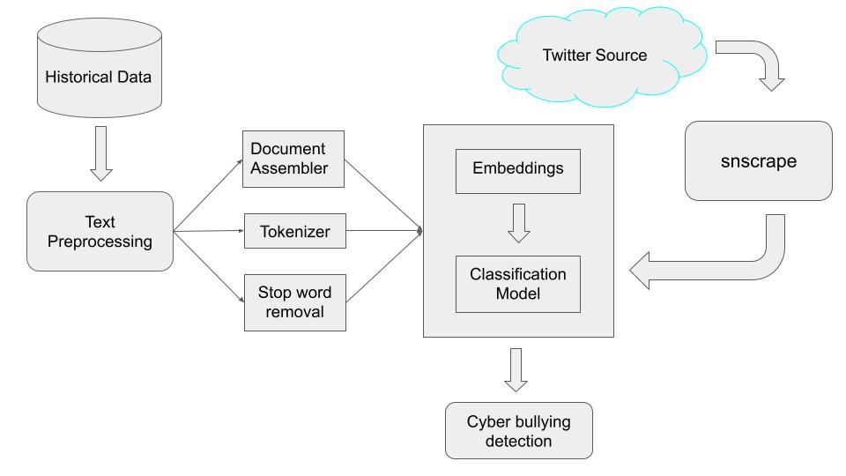
Fig -1
Architecture of the Project

Slide 9
Methodology
The methodology for real-time cyberbullying detection on Twitter using Spark NLP would involve the following steps:
Collect a dataset of tweets from Kaggle. This dataset will be used to train and evaluate the system.
Preprocess the collected data by cleaning and normalizing the text, removing any irrelevant or sensitive information, and organizing the data into a suitable format for analysis.
Perform feature engineering on the cleaned data by using Document Assembler used to combine multiple columns of text data into a single column of document objects.
Convert the document object into a dense vector of numbers that represents sentence in the text using pre-trained models like Universal Sentence Encoder
Build a real-time cyberbullying detection model using the ClassifierDLApproach. The ClassifierDL annotator uses a deep learning model (DNNs) we have built inside TensorFlow and supports up to 100 classes.

Slide 10
Methodology
Fine tune the Deep learning model using various parameters like learning rate, number of epochs, batch size, validation split etc.,
This model is capable to classify the cyber bullying into 6 classes – Religion, Gender, Ethnicity, Age, other_cyberbullying and no cyberbullying
Evaluate the performance of the fine-tuned model on a held-out test set to assess their accuracy and robustness.
Use the trained model to make predictions on new data collected in real-time from Twitter using snscrape to ingest streaming data from Twitter.
Overall, this methodology would provide a systematic and rigorous approach to developing and evaluating a real-time cyberbullying detection system using Spark NLP.

Slide 11
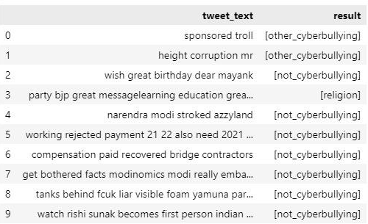
Work done so far
So far, we have obtained a dataset from Kaggle that contains approximately 47000 rows of twitter messages and a cyberbullying type column that contains six different groups - Age, Ethnicity, Gender, Religion, Other cyberbullying, and Not cyberbullying.
Cleaned the dataset by removing duplicates and empty strings
Preprocessed the text data by removing punctuation, hashtags, stopwords, and so on;
Created a pipeline consisting of a series of phases for feature vectorization and sentence embeddings
The pipeline concludes with the ClassifierDLApproach model, which is used to train embeddings from universal sentence encoders.
Achieved 89.3% training accuracy and 84.09% testing accuracy
Fig -3

Slide 12
Software and Hardware requirement
Software Requirements -
Python 3.7 or later
Jupyter notebook or any python IDE
Windows 7 or later
Python libraries - Spark, Pandas, Numpy and Data visualization libraries
GPU Drivers
Hardware Requirements -
Intel i3/i5/i7 or Equivalent AMD processors
Entry level discrete gpu or above (Nvidia MX, GTX, RTX series or Intel iris xe)
4+GB ram
<128GB Storage

Slide 13
References
Mitushi Raj, Samridhi singh, Kanishka Solanki, Ramani Selvanambi. An Application to Detect Cyberbullying Using Machine Learning and Deep Learning Techniques, Published online 2022 Jul 26, doi: 10.1007/s42979-022-01308-5
Aditya Desai, Shashank Kalaskar, Omkar Kumbhar, Rashmi Dhumal. Cyber Bullying Detection on Social Media using Machine Learning. ITM Web of Conferences 40, 03038 (2021), doi: https://doi.org/10.1051/itmconf/20214003038
Muskan Patidar, Mahak Lathi, Manali Jain, Monika Dhakad, Prof. Yamini Barge. “Cyber Bullying Detection for Twitter Using ML Classification Algorithms,” IJRASET, 2021
Andrea Pereraa , Pumudu Fernando, “Accurate Cyberbullying Detection and Prevention on Social Media,” ,2020, doi: https://doi.org/10.1016/j.procs.2021.01.207
Saloni Mahesh Kargutkar, Prof. Vidya Chitre “A Study of Cyberbullying Detection Using Machine Learning Techniques”, IEEE, 2020

Slide 14
References
González-Ibánez, R. , Muresan, S. , & Wacholder, N. (2011, June). Identifying sarcasm in twitter: A closer look. In Proceedings of the 49th Annual Meeting of the Association for Computational Linguistics: Human Language Technologies: Short Papers-volume2 (pp. 581–586), Portland, Oregon.
Ennaji, F. Z. , El Fazziki, A. , Sadgal, M. , & Benslimane, D. (2015, November). Social intelligence framework: Extracting and analyzing opinions for social CRM. In Computer Systems and Applications (AICCSA), 2015 IEEE/ACS 12th International Conference of (pp. 1–7). Marrakech, Morocco: IEEE.
Barskar, A. , & Phulre, A. (2017). Opinion mining of twitter data using Hadoop and Apache Pig. International Journal of Computer Applications , 158, 9. doi:10.5120/ijca2017912854
Tare, M. , Gohokar, I. , Sable, J. , Paratwar, D. , & Wajgi, R. (2014). Multi-class tweet categorization using map reduce paradigm. International Journal of Computer Trends and Technology (IJCTT) , 9(2), 78–81. doi:10.14445/22312803/IJCTT-V9P117
Peiling Yia, Arkaitz Zubiaga. Session-based Cyberbullying Detection in Social Media.

